Slide 1
Data-driven health (BMEN35)
Department of Biomedical Engineering

Slide 2
Omics and interpretable machine learning Data-driven Life Science Erik Hartman

Slide 3
Agenda
What is omics
Typical omics data
Example with proteomics and MS
Typical omics differential expression analysis
ML on omics data
SHAP
Biologically informed neural networks

Slide 4
Omics
What is omics
Omics aims at the collective characterization and quantification of pools of biological molecules that translate into the structure, function, and dynamics of an organism or organisms
-omics, -ome

Slide 5
The goal
What is omics
Identifying, quantifying and characterizing large quantities of biological molecules.
Often to connect molecule with disease, and thereby find therapeutical targets or means of diagnosis.

Slide 6
Omics
What is omics
Genomics – study of genomes
Transcriptomics – study of RNA
Epigenomics – study of epigenetic modifications
Proteomics – study of proteins
Peptidomics – study of short amino acid sequences (peptides)
Microbiomics – study of the microbiome
Metabolomics – study of metabolites
…
(my domains)

Slide 7
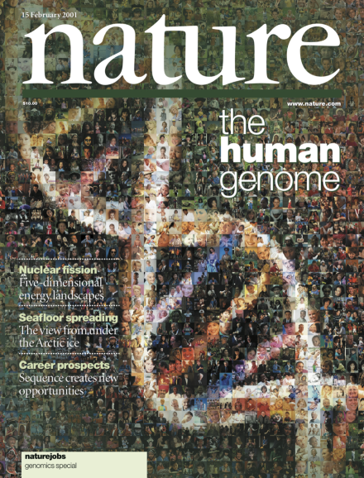
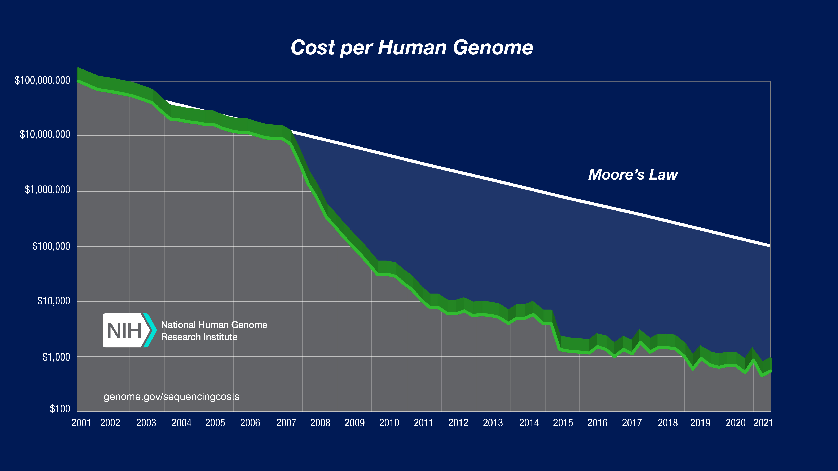
Why prevalent now
What is omics
Data gathering capabilities increased
Data processing capabilities increased
Human genome project

Slide 8
Why prevalent now
What is omics
Databases
UniProt (https://www.uniprot.org/uniprotkb/P69905/entry)
Ensembl
ProteomicsDB
Protein Atlas (https://www.proteinatlas.org/)
Reactome
…

Slide 9
Omics processing pipeline
What is omics
Data gathering machine (e.g., mass-spec, sequencer etc.)
“Raw data”
Biological sample (e.g., singe cell, blood plasma etc.)
Processed data
Processing
Conclusion
Post processing analysis

Slide 10
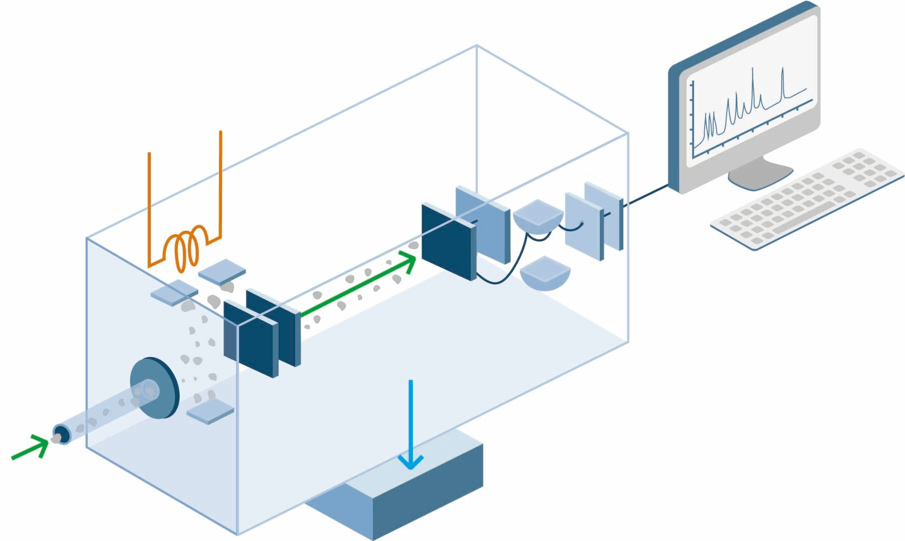
What does omics data look like?
Typical omics data
- The raw data is highly dependent on the machine and omics field
The processed data is a bit more generalized
Example: mass spectrometry and proteomics

Slide 11
What does omics data look like?
Typical omics data
The molecules in the sample are separated based on their mass-to-charge-ratio (m/z)
Raw output
Hits sensor
Fractionated and separated
Sample goes here
*note: there are many different types of MS modes – I show a sort of “generalized” version

Slide 12
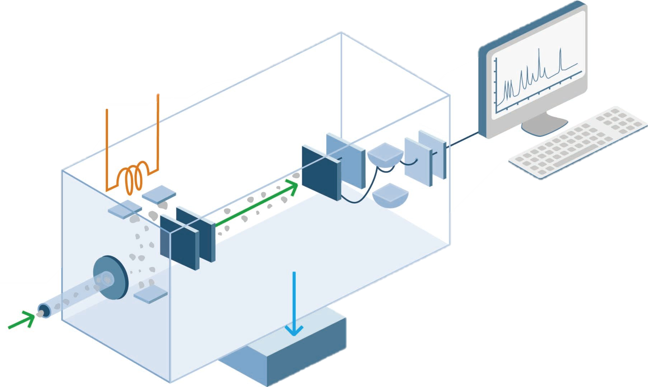
What does omics data look like?
Typical omics data
The molecules in the sample are separated based on their mass-to-charge-ratio (m/z)
Raw output
Hits sensor
Fractionated and separated
Mass spectra
ABC
BC
AB
Sample goes here
Intensity
C
A
B
m/z

Slide 13
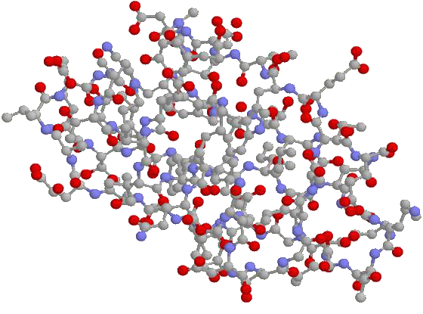
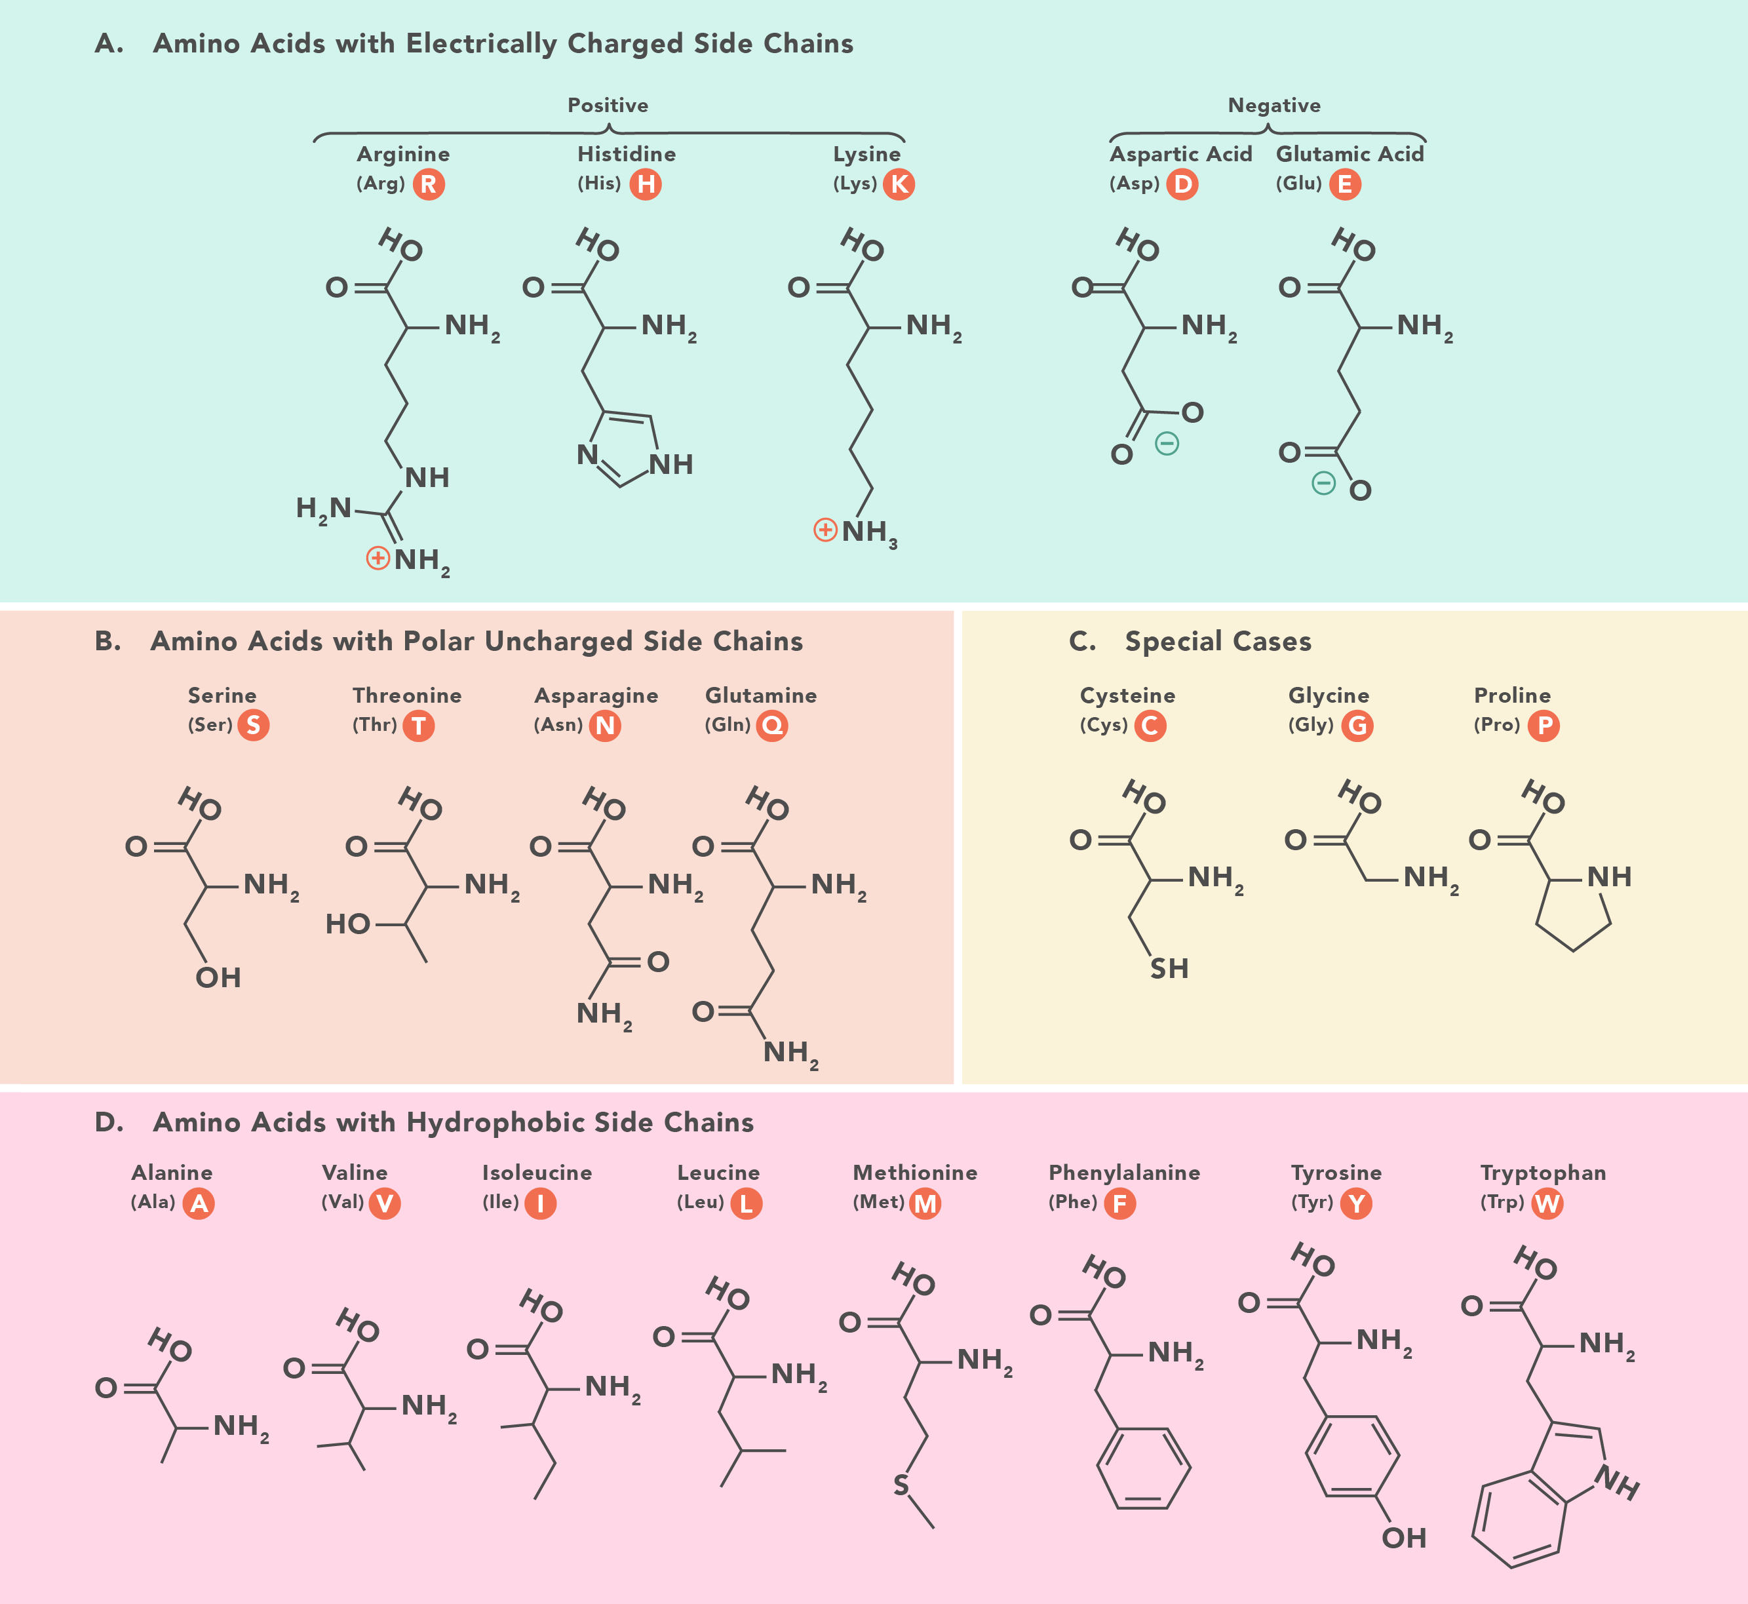
Case: mass spec in a proteomics context
Typical omics data
Goal: get the proteomic content of the sample
A protein is a large and complex molecule, and the spectra for a protein would be too complicated to untangle.

Slide 14
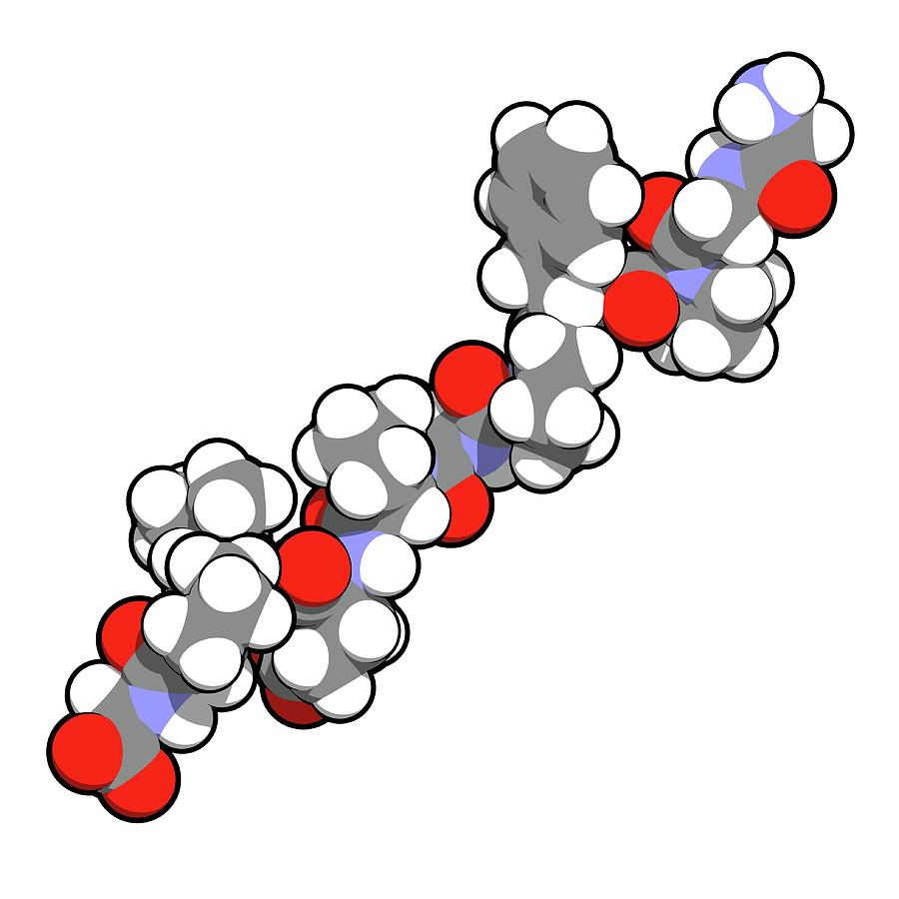
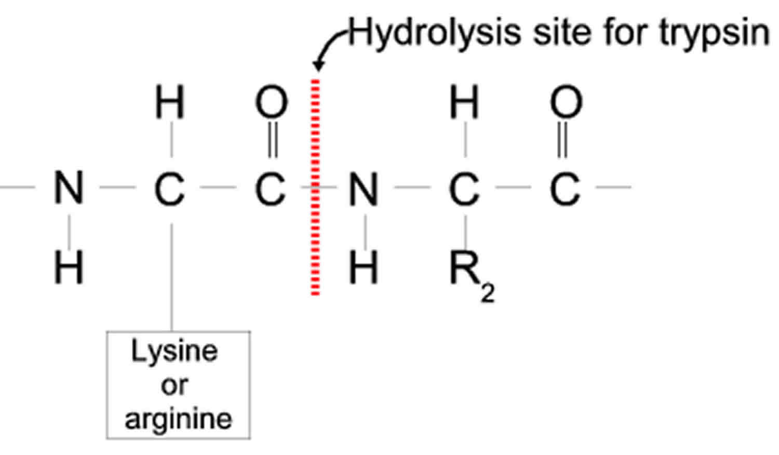
Case: mass spec in a proteomics context
Typical omics data
Goal: get the proteomic content of the sample
A protein is a large and complex molecule, and the spectra for a protein would be too complicated to untangle when you have many proteins in the sample.
Therefore, we break it down.
enzyme
Commonly trypsin

Slide 15
Case: mass spec in a proteomics context
Typical omics data
Goal: get the proteomic content of the sample
A protein is a large and complex molecule, and the spectra for a protein would be too complicated to untangle when you have many proteins in the sample.
Therefore, we break it down. A short peptide can be distinguished in the spectra when separated on their m/z.
Mass spectra
ABC
BC
AB
Intensity
C
A
B
Peptide
m/z
Spectra

Slide 16
Case: mass spec in a proteomics context
Typical omics data
Goal: get the proteomic content of the sample
Mass spectra
ABC
BC
AB
Intensity
C
A
B
“VHLTPEEKSAV”
m/z

Slide 17
Case: mass spec in a proteomics context
Typical omics data
Goal: get the proteomic content of the sample
The MS outputs peptides that come from some protein.
Peptide | Abundance | Protein | Other types of data
VHLTPEEK | 3 | HBA
HGPPLE | 7 | VTNC
ILEEK | 5 | FIBA
…
…
…
…

Slide 18
Case: mass spec in a proteomics context
Typical omics data
Goal: get the proteomic content of the sample
The MS outputs peptides that come from some protein.
Entity | Abundance | Other types of data
X₁ | 3
X₂ | 7
X₃ | 5
…
…
…
…
This is the general form of omics-data

Slide 19
Case: mass spec in a proteomics context
Typical omics data
Peptide | Abundance | Protein | Other types of data
VHLTPEEK | 3 | HBA
HGPPLE | 7 | VTNC
ILEEK | 5 | FIBA
…
…
…
…
We can use this data to quantify the proteins in the sample.
Often, we don’t care about the absolute quantity – but more so about the relative quantity between samples.
There are many different algorithms for relative quantification of proteins from peptides. The “best” one currently is called MaxLFQ.

Slide 20
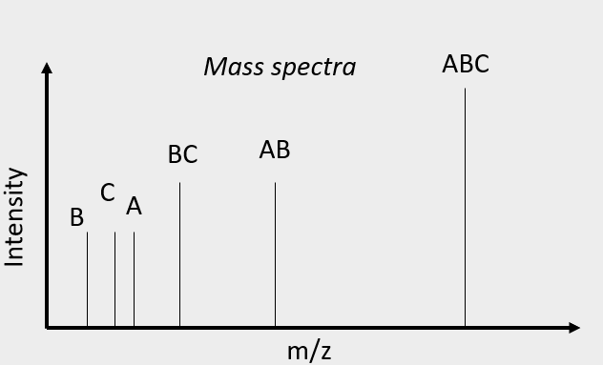
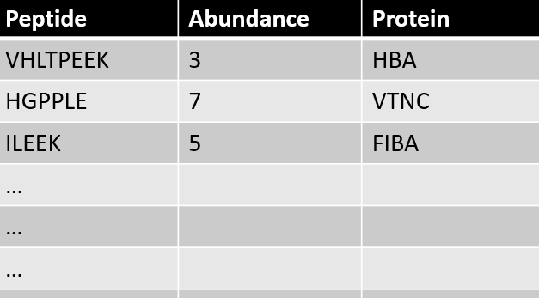
Case: mass spec in a proteomics context
Typical omics data
MS
?
enzyme
Requires some knowledge about the sample
Raw data
!
Omics dataset

Slide 21
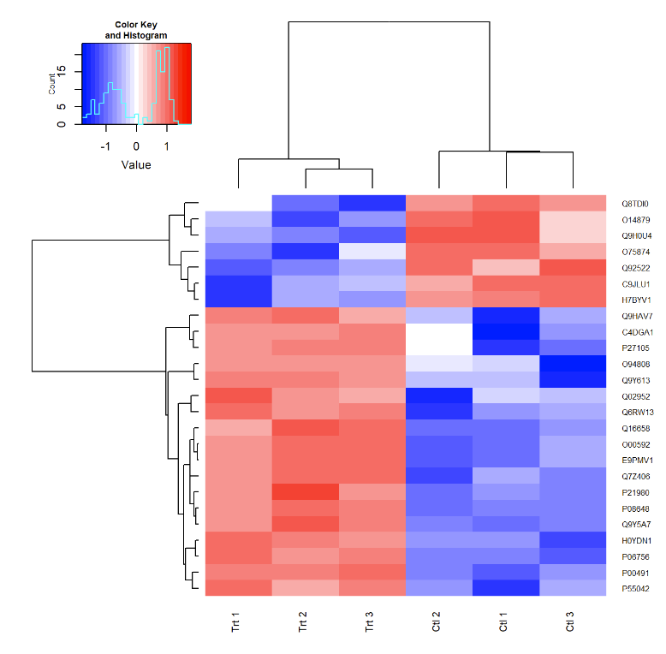
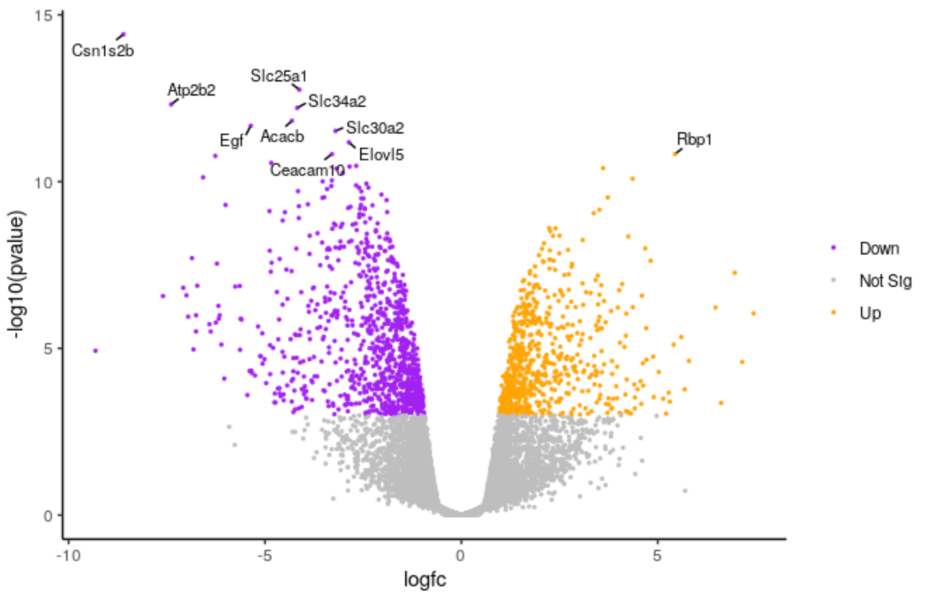
Differential expression
Differential expression
how much do groups differ?
Heatmap with clustering
Volcano plot
Note: UniProt IDs vs. protein names
P69905 – HBA_HUMAN (haemoglobin alpha from human)
https://training.galaxyproject.org/training-material/topics/transcriptomics/tutorials/rna-seq-viz-with-volcanoplot/tutorial.html

Slide 22
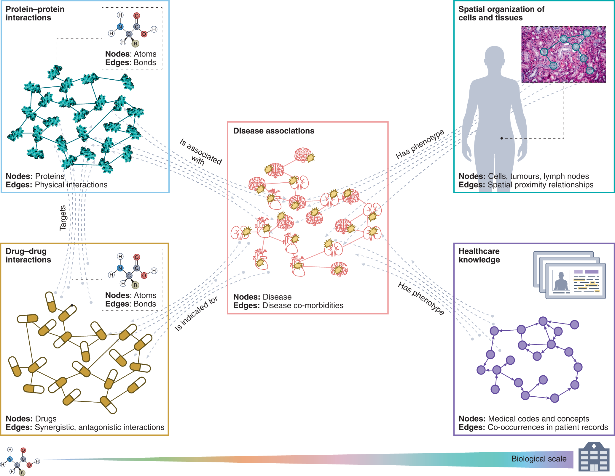
Graphs
Pathway analysis
Can we put molecules into a broader context?
Li, M.M., Huang, K. & Zitnik, M. Graph representation learning in biomedicine and healthcare. Nat. Biomed. Eng 6, 1353–1369 (2022). https://doi.org/10.1038/s41551-022-00942-x

Slide 23
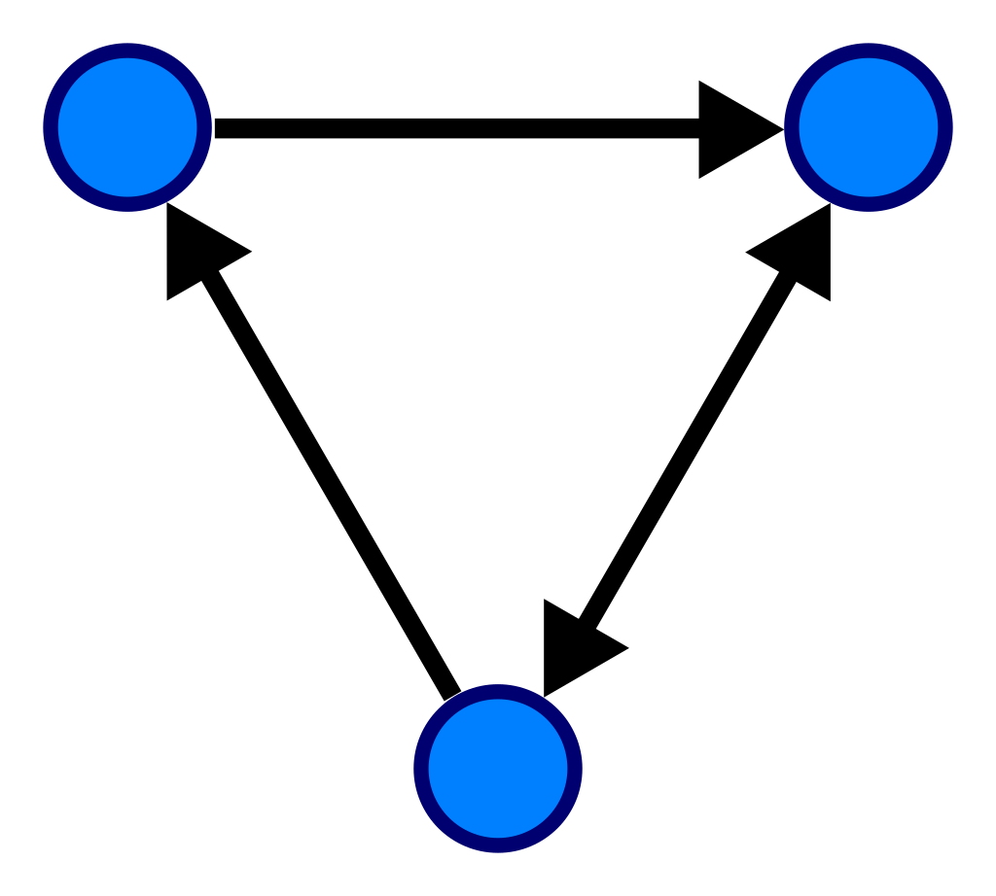
Graphs
Graphs
A graph is a data type that captures both information about entities and about their relationship.
node
edge
*

Slide 24
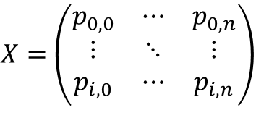
Machine learning on omics data
ML
High dimensional data. Suitable for ML methods!
Classification of e.g. disease
$X=$ $\left(\begin{matrix}p_{0,0} & ⋯ & p_{0,n} \\ ⋮ & ⋱ & ⋮ \\ p_{i,0} & ⋯ & p_{i,n}\end{matrix}\right)$
Some ML model
Regression of disease severity
Quantified proteins
*

Slide 25
SHAP
“The best explanation of a simple model is the model itself; it perfectly represents itself and is easy to understand. For complex models, such as ensemble methods or deep networks, we cannot use the original model as its own best explanation because it is not easy to understand.”
We need explanation models to help us interpret them

Slide 26
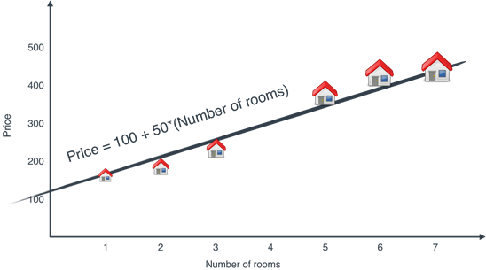
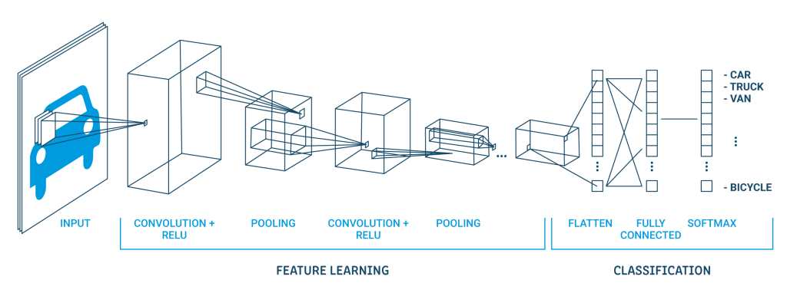
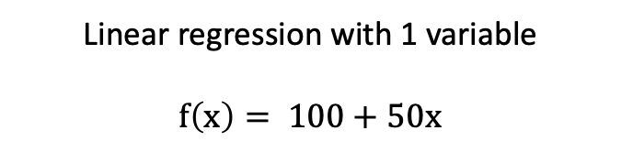

Example of glass box vs. black box model
ML
Linear regression with 1 variable
$$f\left(x\right)= 100+50x$$
Deep network
$f_{0}(f_{1}$($f_{2}$….

Slide 27
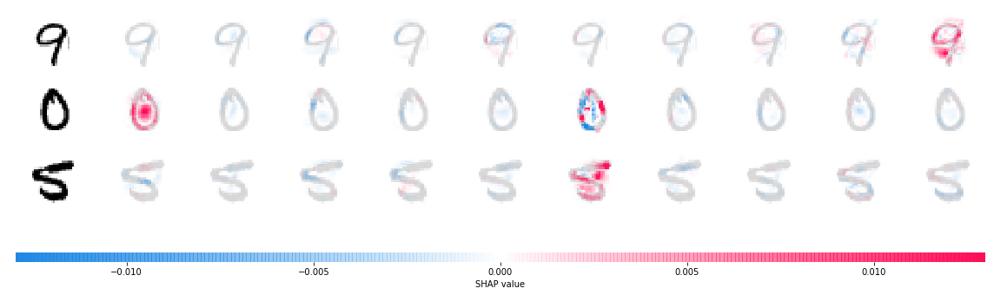
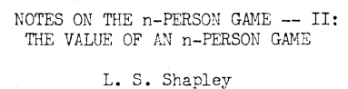
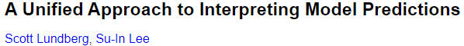
SHAP
SHAP
1951
2017
Shapley values
SHAP values
SHapley Additive exPlanations
workers
features
prediction
“0”
product
If we want to pay the workers according to their contribution, how do we decide each workers pay?
How much did each feature contribute to the prediction?
*

Slide 28
Machine learning on omics data
ML
High dimensional data. Suitable for ML methods!
Classification of e.g. disease
$X=$ $\left(\begin{matrix}p_{0,0} & ⋯ & p_{0,n} \\ ⋮ & ⋱ & ⋮ \\ p_{i,0} & ⋯ & p_{i,n}\end{matrix}\right)$
Some ML model
Regression of disease severity
Quantified proteins
Interpret using e.g., SHAP
Important proteins
*

Slide 29
ML
Interpreting a biologically informed neural networks

Slide 30
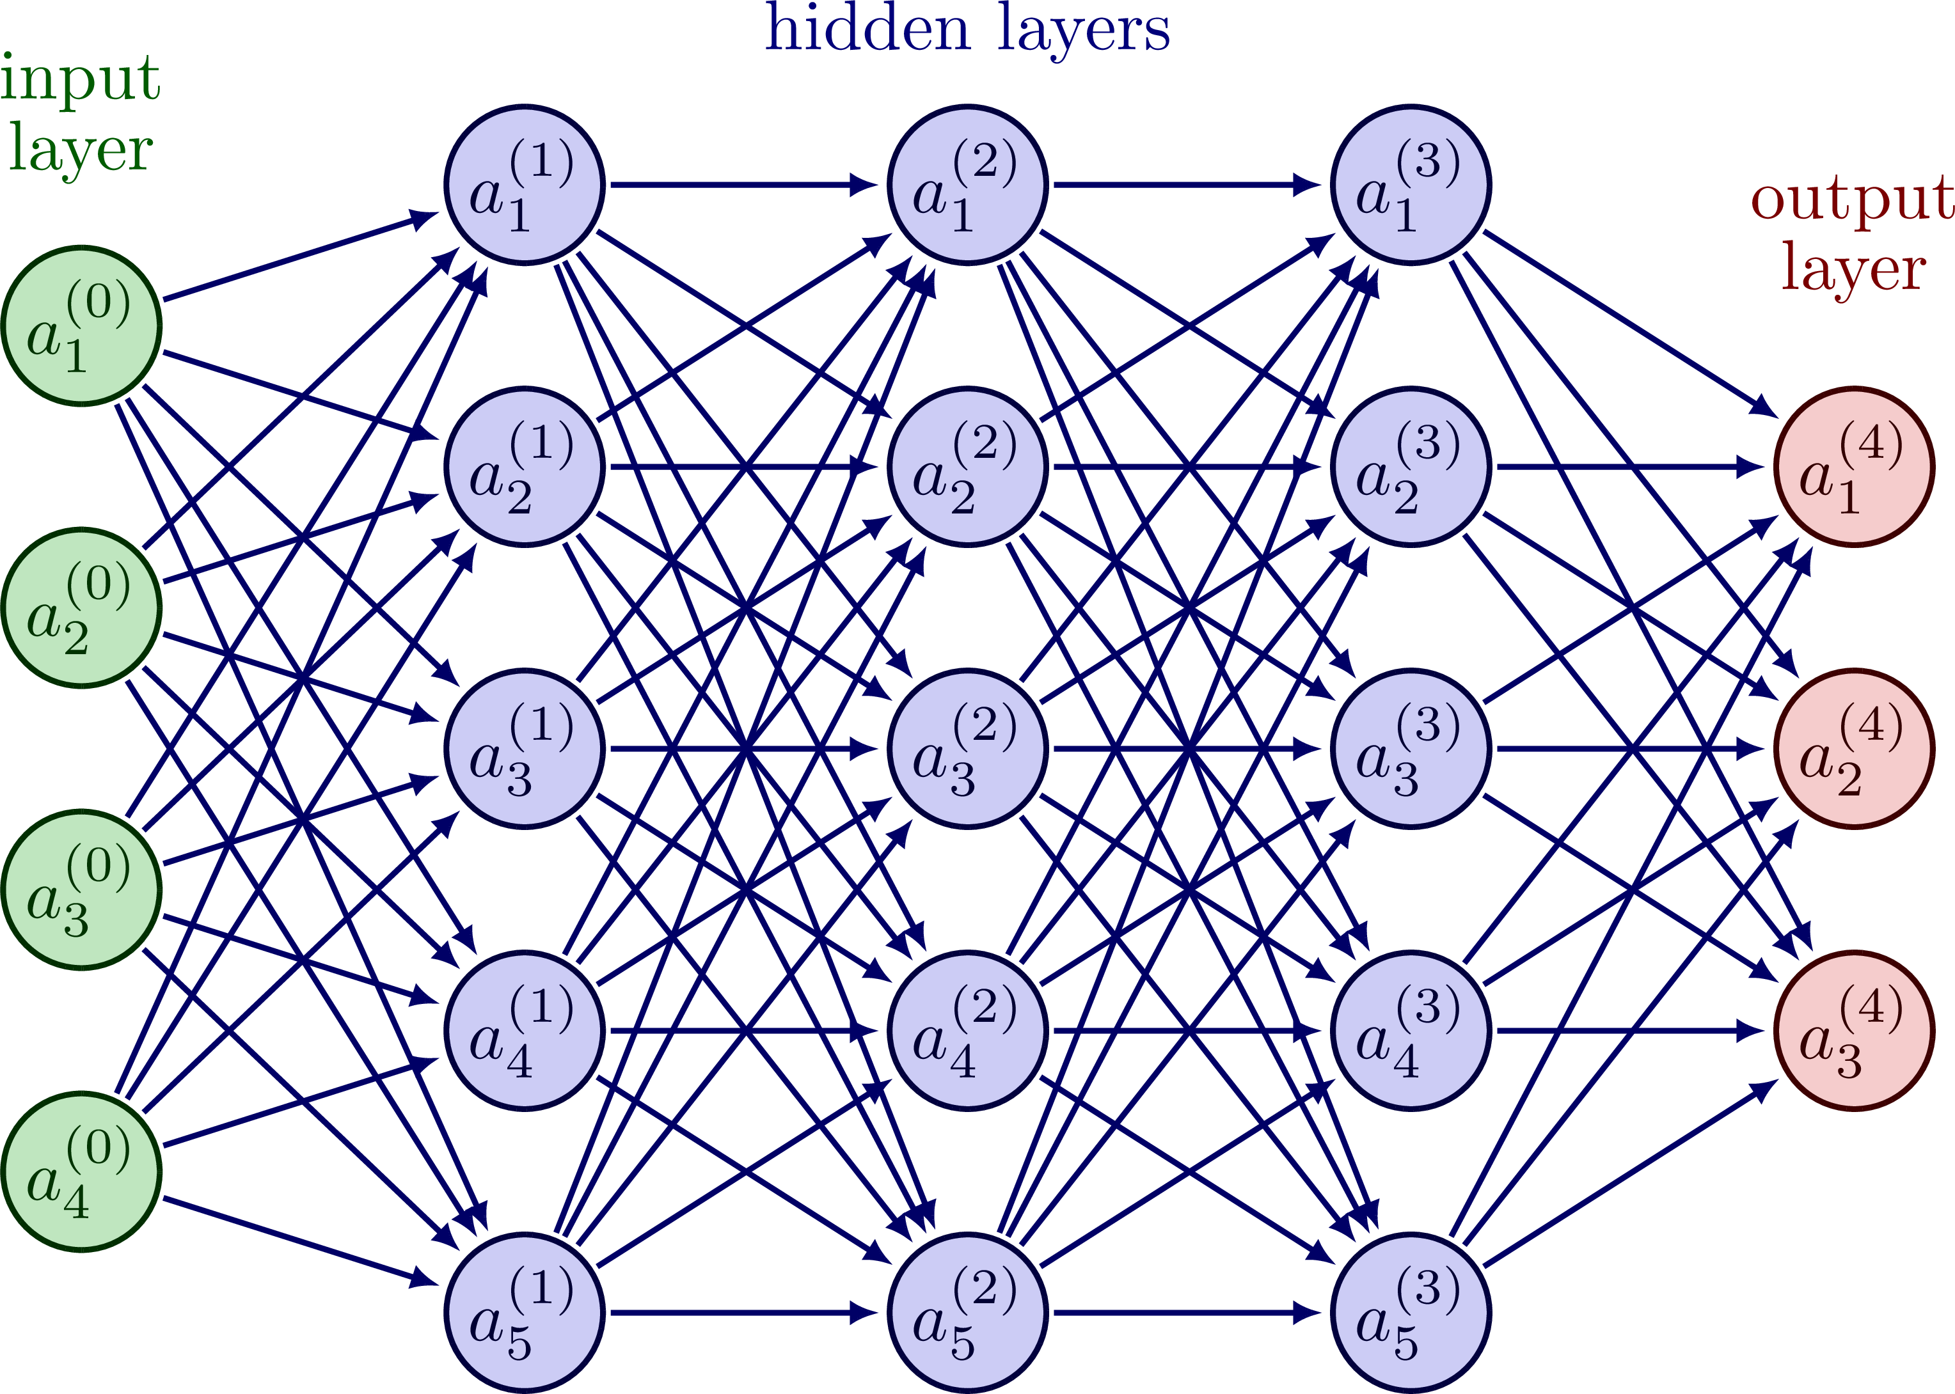
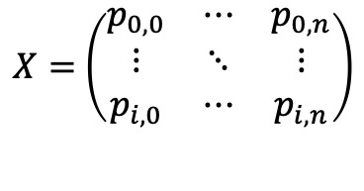
(Prote)omics context
ML
Quantified proteins
Classification of e.g. disease
$X=$ $\left(\begin{matrix}p_{0,0} & ⋯ & p_{0,n} \\ ⋮ & ⋱ & ⋮ \\ p_{i,0} & ⋯ & p_{i,n}\end{matrix}\right)$
Regression of disease severity
DeepExplainer (modified DeepLift with SHAP)
Important proteins
Replacing DE-analysis

Slide 31
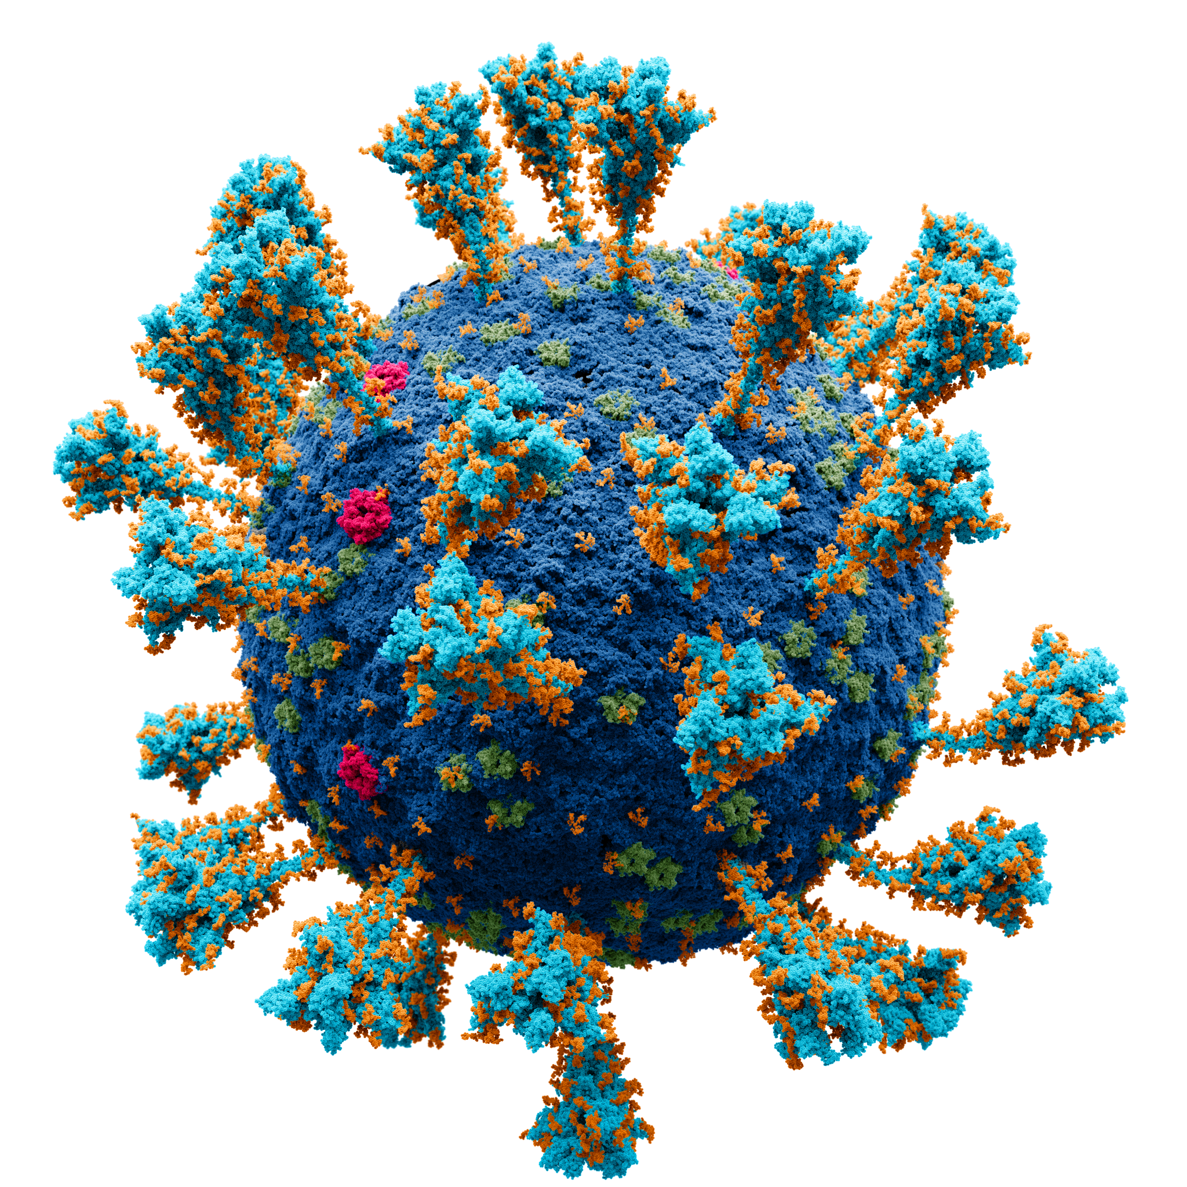
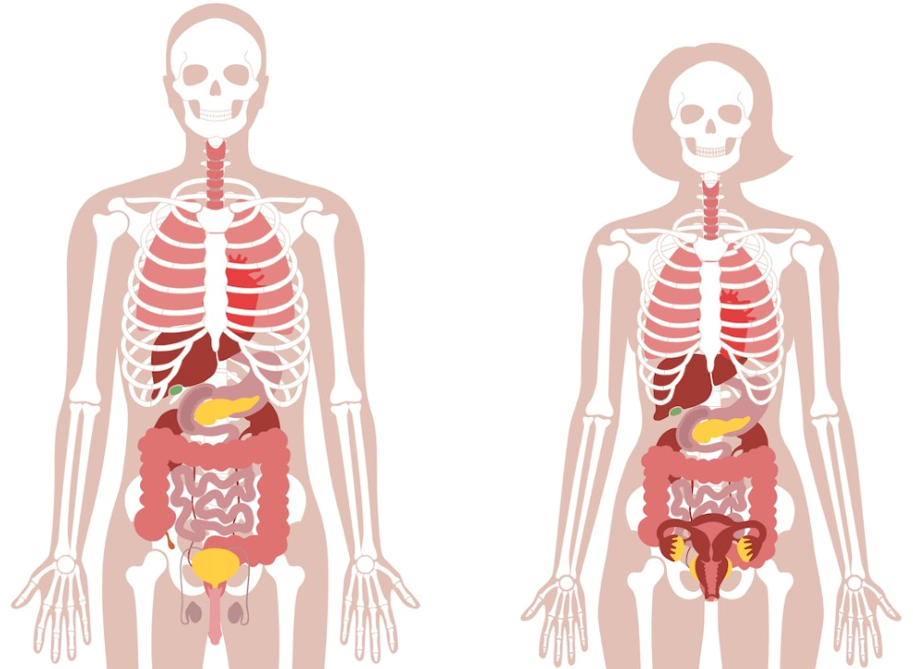
ML
inflammatory processes
Sepsis
Cellular immune response
Humoral immune response
Early response
time
DAMP/PAMP
anti-inflammatory processes
Initiating infection
TLR
Dysregulation in immune response
50 million cases/year
Responsible for 20% of global deaths

Slide 32

ML
Sepsis
Syndrome – collection of symptoms
Coagulopathy
ARDS
AKI
Septic chock
…
Subphenotype 1
Subphenotype 2

Slide 33
ML
Sepsis
Syndrome – collection of symptoms
Coagulopathy
ARDS
AKI
Septic chock
…
Subphenotype 1
Subphenotype 2
Problem
Sepsis is a complex and diverse syndrome. Further understanding of the underlying biology of endotypes and subphenotypes is necessary for targeted therapeutics.

Slide 34
ML
Aim
Utilize machine learning to enhance our understanding of the underlying biology of 2 subphenotypes of septic AKI
*we also added a COVID-19 dataset, but you know about that disease already

Slide 35
(Prote)omics context
ML
Quantified proteins
Classification of e.g. disease
$X=$ $\left(\begin{matrix}p_{0,0} & ⋯ & p_{0,n} \\ ⋮ & ⋱ & ⋮ \\ p_{i,0} & ⋯ & p_{i,n}\end{matrix}\right)$
Regression of disease severity
DeepExplainer (modified DeepLift with SHAP)
Important proteins
Replacing DE-analysis

Slide 36
Can we do something similar with pathway-analysis?

Slide 37
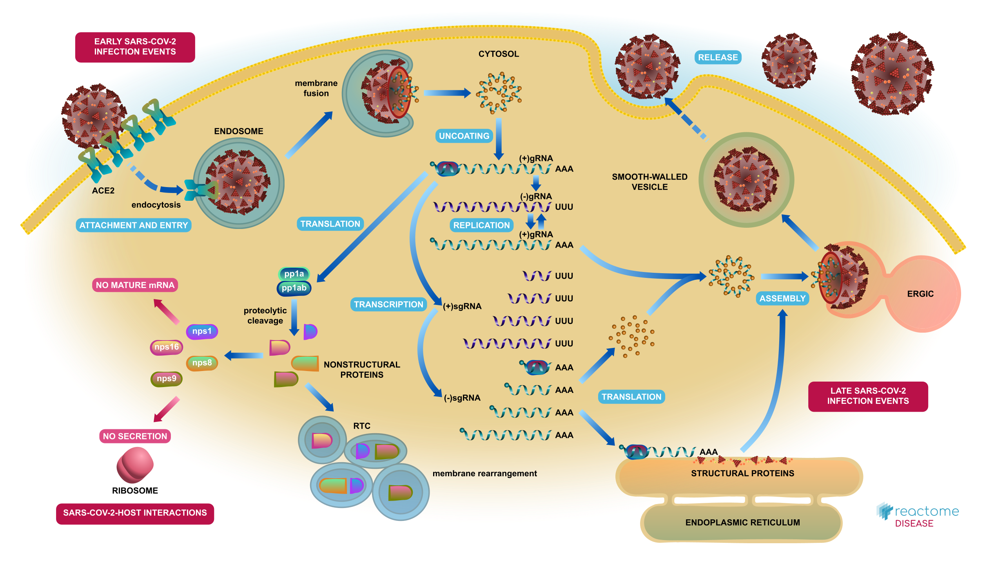
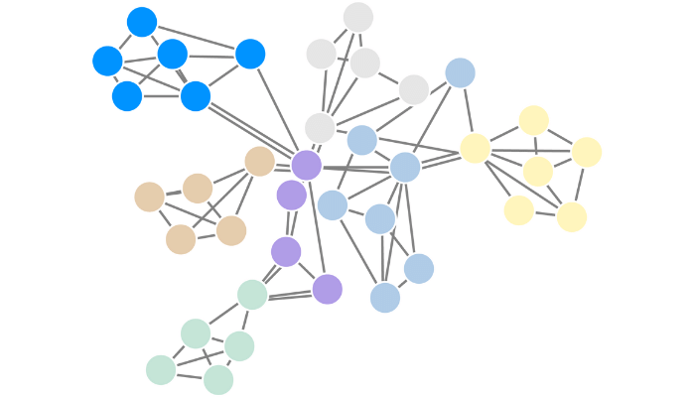
Reactome pathway database
Protein
Procathepsin L
TLR processing at low PH
TLR cascades
Increasing level of abstraction
Trafficking and processing of endosomal TLR
Innate immune system
Immune system
Higher level processes
Most pathway databases are just hierarchical graphs

Slide 38





ML
Procathepsin L
TLR cascades
Innate immune system
$$w$$
$$w$$
$$w$$
$$w$$
Trafficking and processing of endosomal TLR
$$w$$
.
.
.
Immune system
Output
.
.
.
.
.
.
.
.
.
Proteins as input
.
.
.

Slide 39
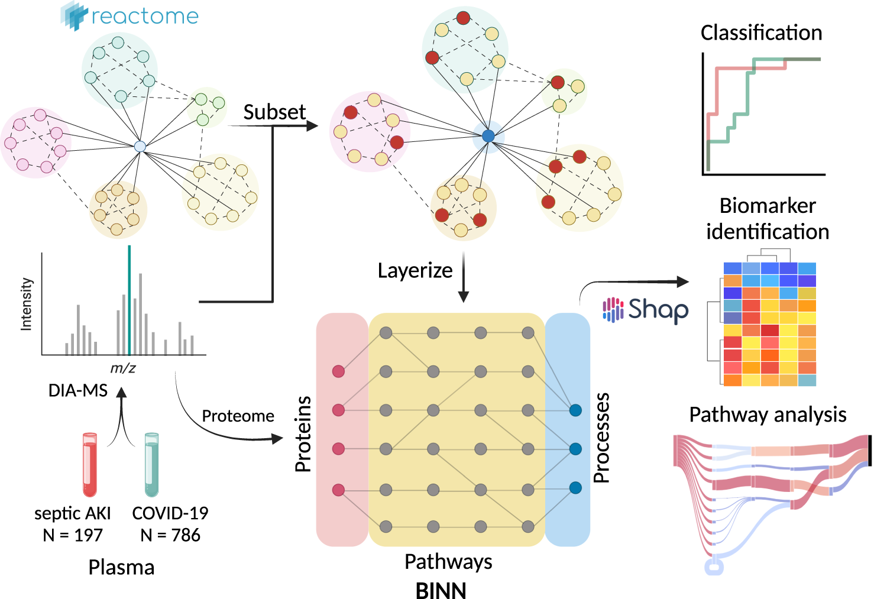
Full workflow

Slide 40
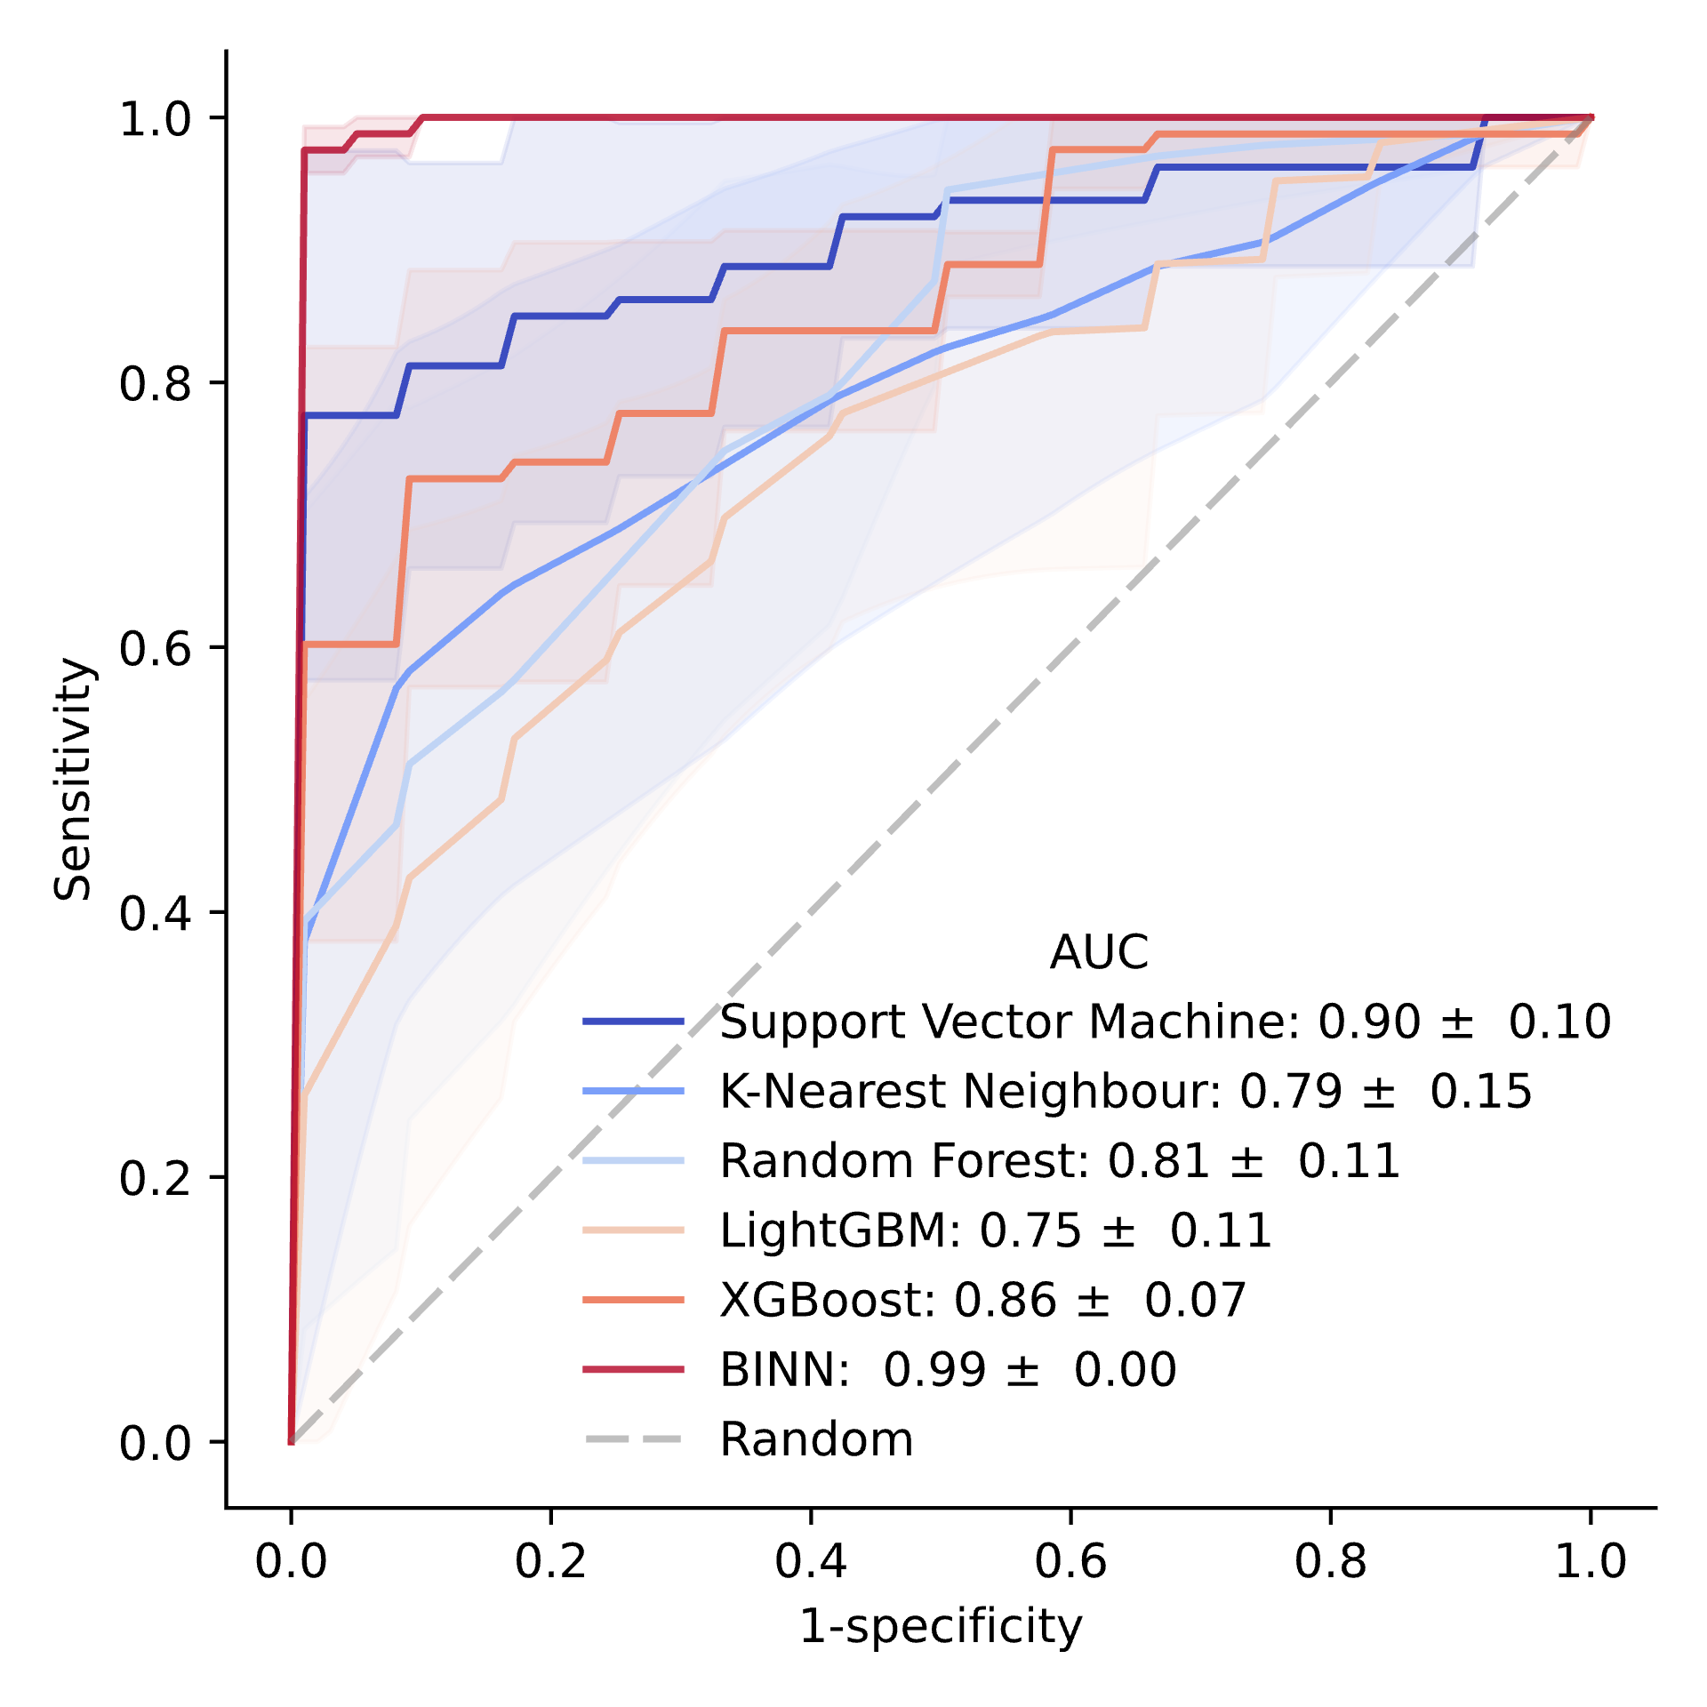
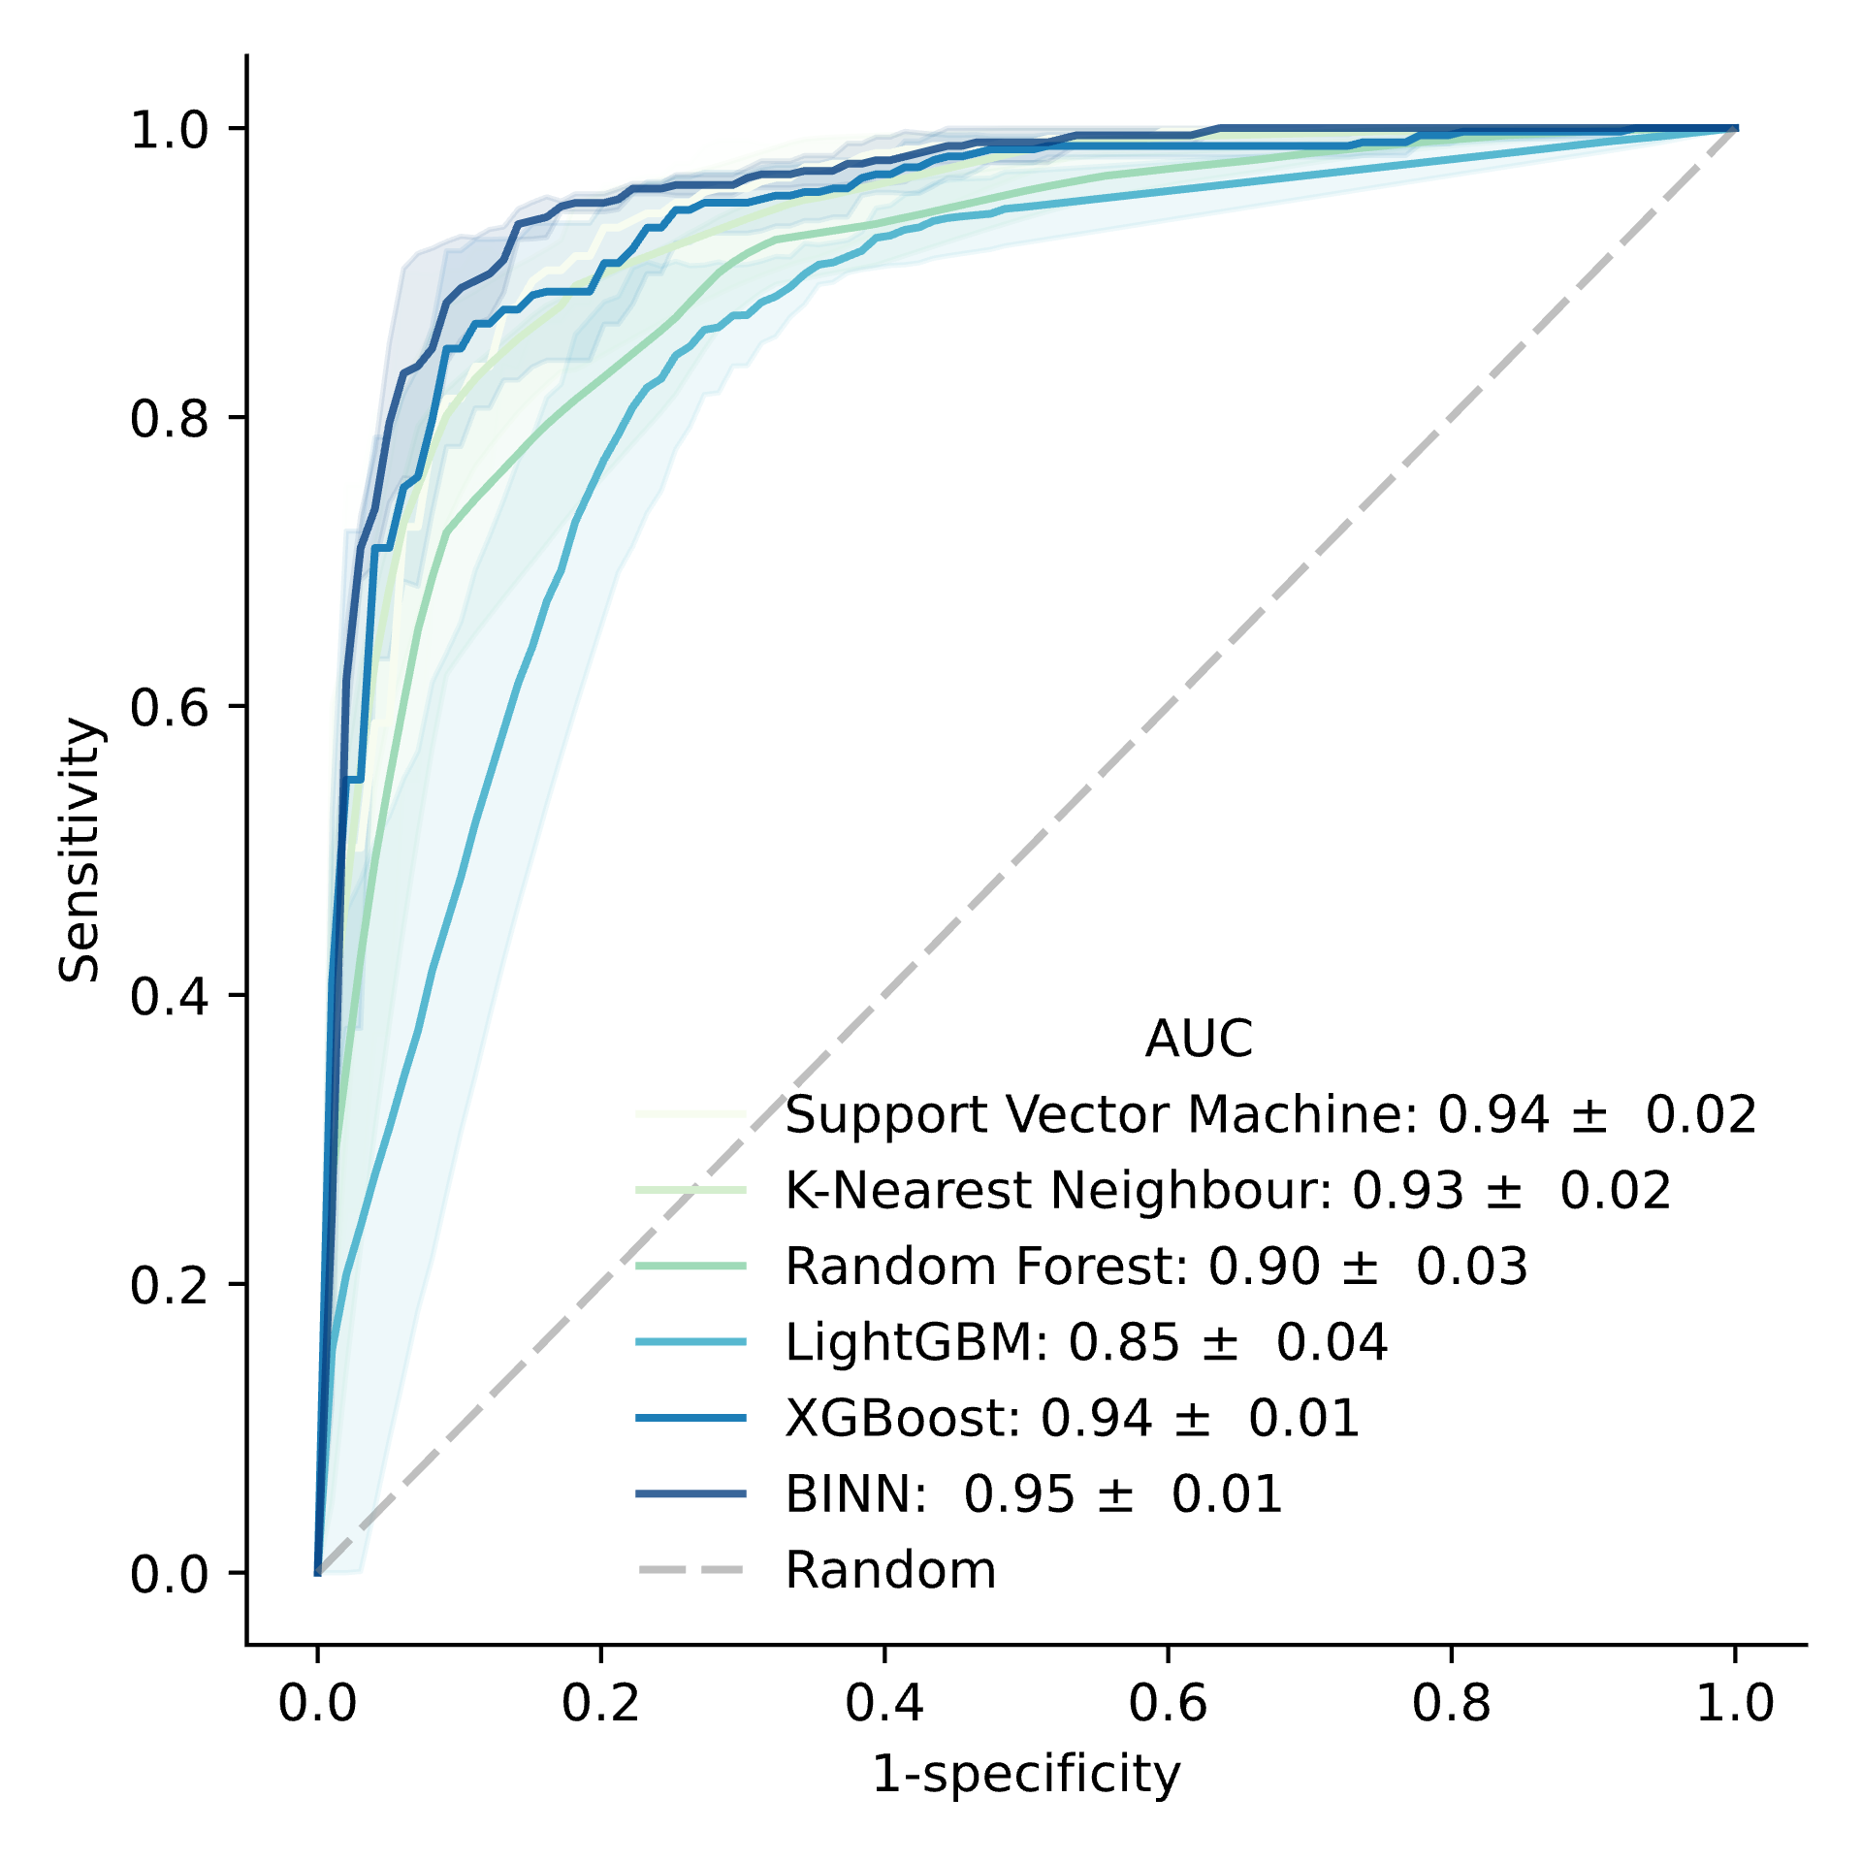
ML
Evaluating the BINN
Protein abundances
$X=$ $\left(\begin{matrix}p_{0,0} & ⋯ & p_{0,n} \\ ⋮ & ⋱ & ⋮ \\ p_{i,0} & ⋯ & p_{i,n}\end{matrix}\right)$
Septic AKI
COVID-19
BINN & ML-methods
K-fold cross validation

Slide 41
ML
Interpreting the network
2017
SHAP values
SHapley Additive exPlanations
features
prediction
“0”
How much did each feature contribute to the prediction?

Slide 42
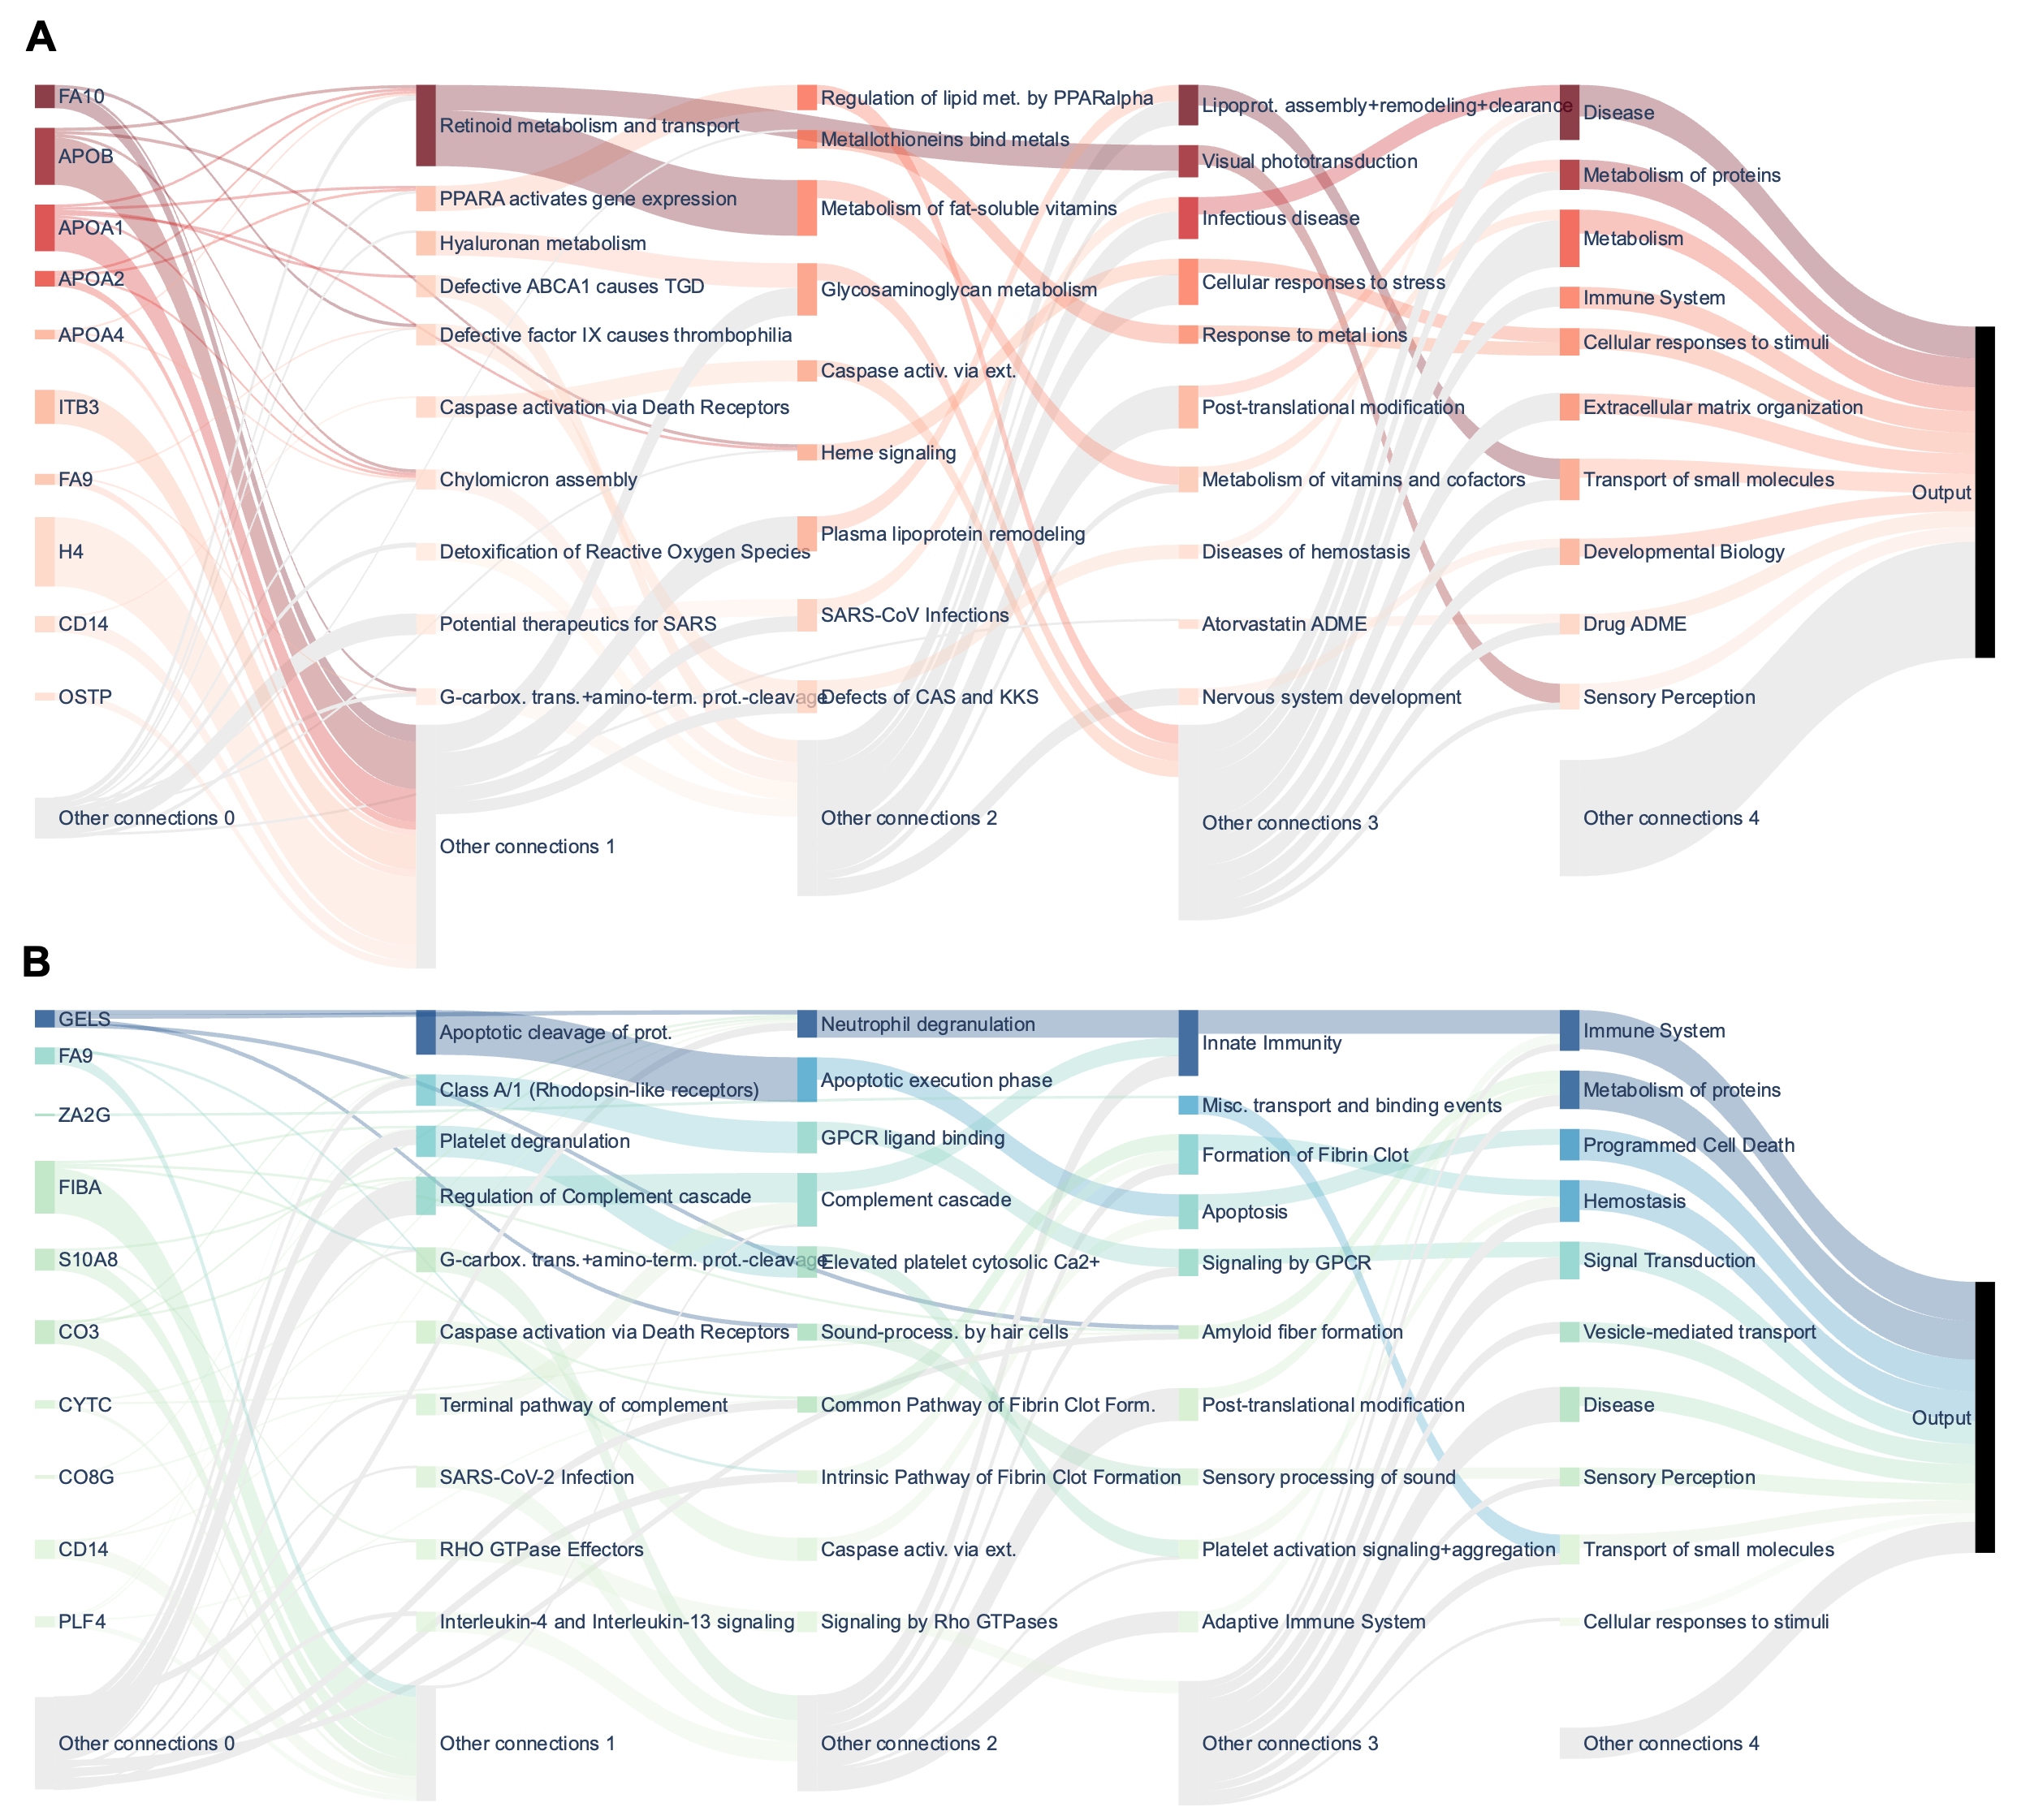
Processes related to metabolic processes and disease
Septic AKI
COVID-19
Processes related to the immune system

Slide 43
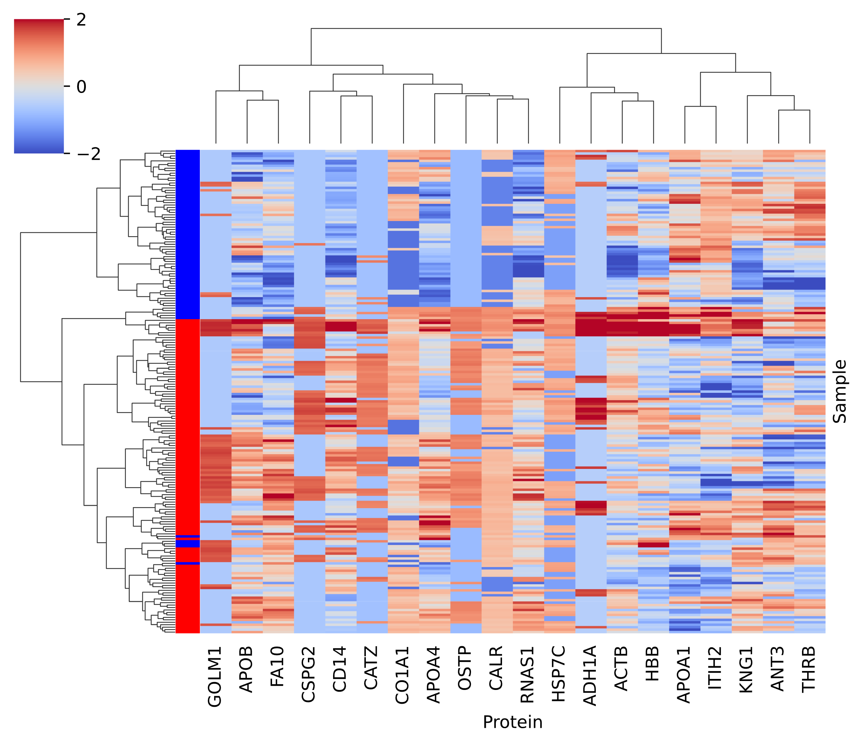
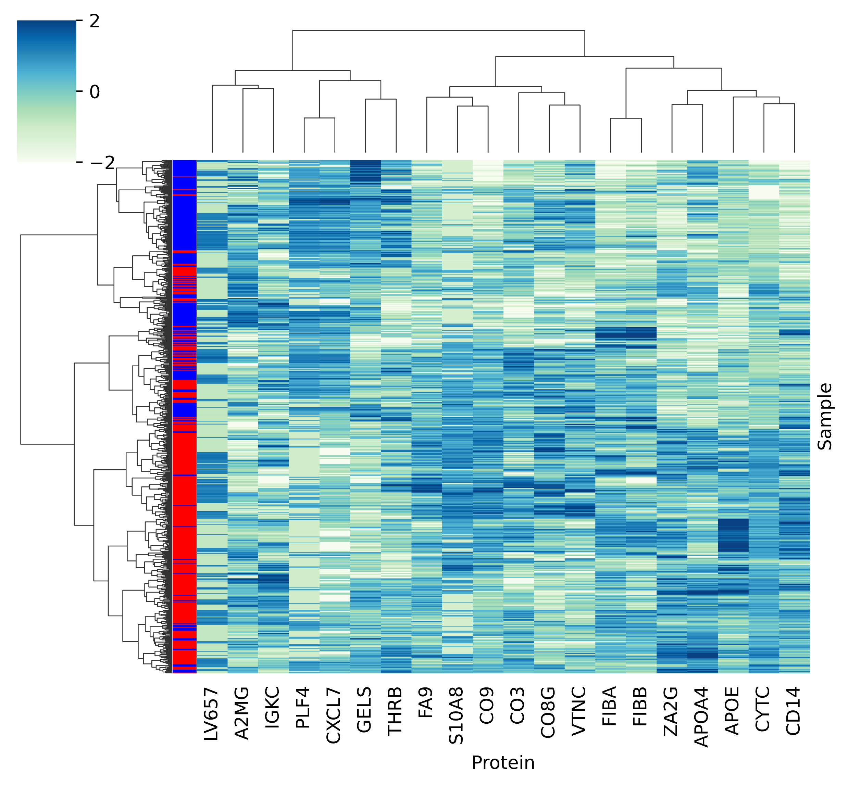
Biomarker identification
Septic AKI
COVID-19
z-score
z-score

Slide 44
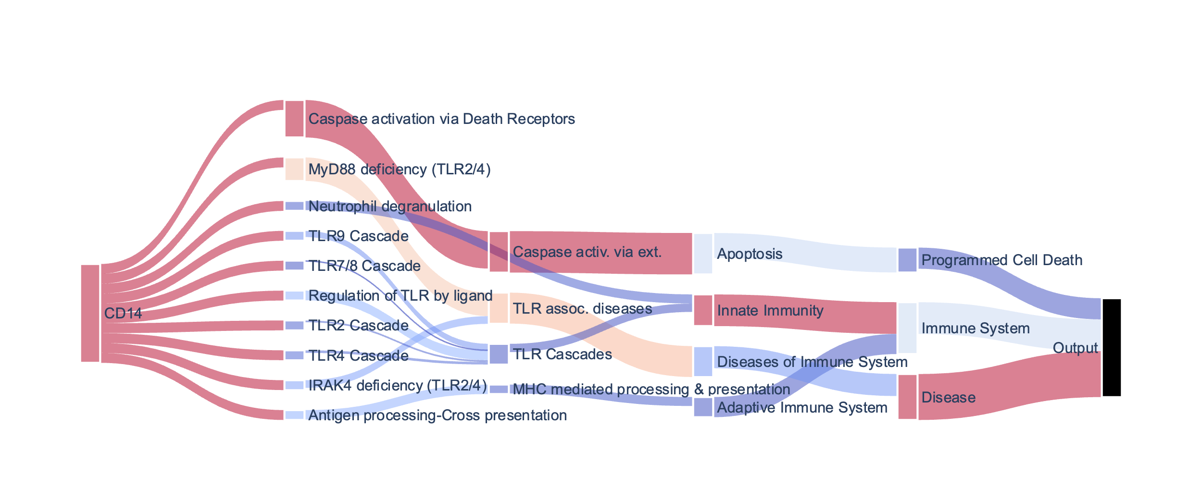
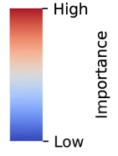
Pathway analysis

Slide 45
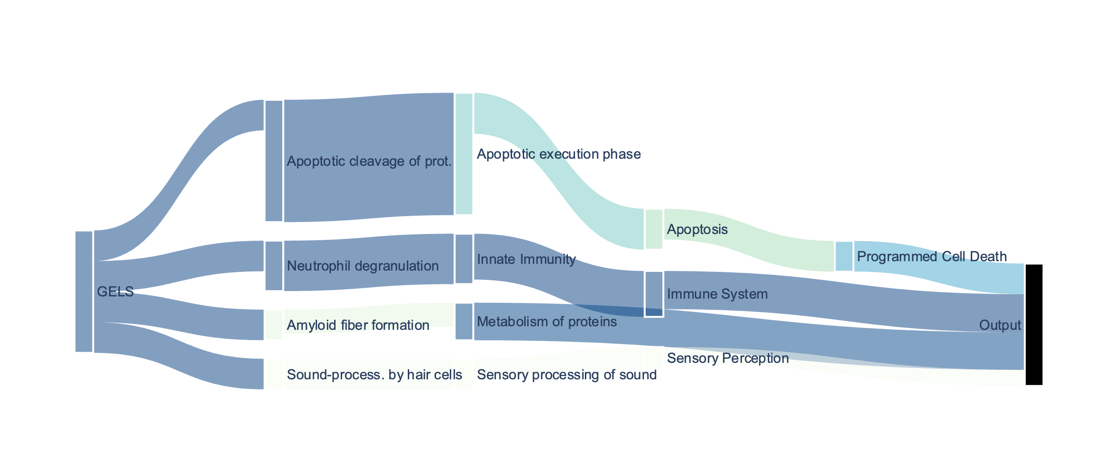
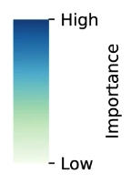
Pathway analysis

Slide 46
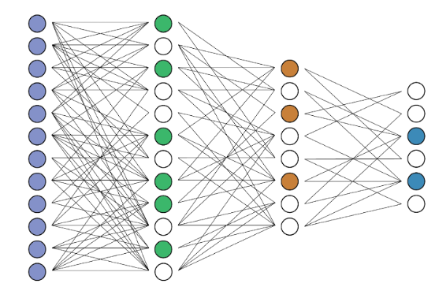
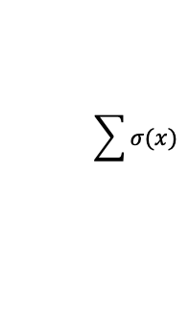
Problems we faced and how we fixed them
1. Are nodes important by themselves, or only due to their connections?
2. Are highly connected nodes considered too important just because they’re highly connected?
1.
2.
Adjusted importance = importance / log(7)
Penalize a node by the number of connections it has.
Since the number of nodes grows exponentially, we divide by the logarithm of the numer of nodes.
$$\sum{σ(x)}$$

Slide 47
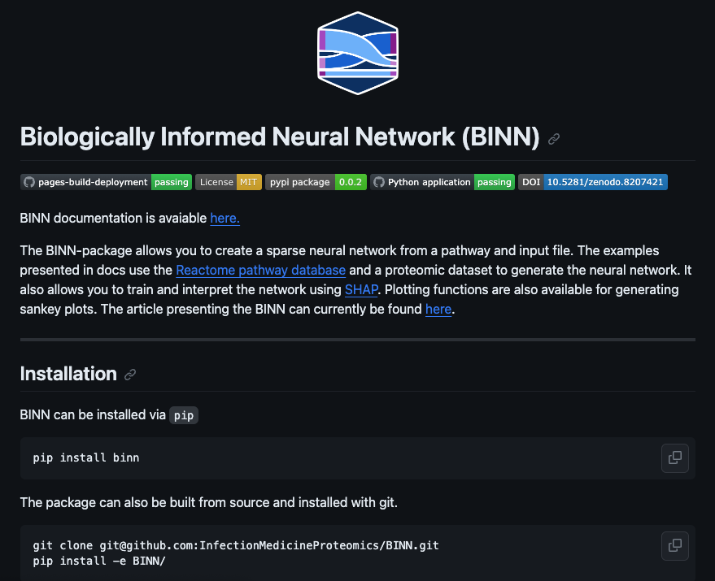
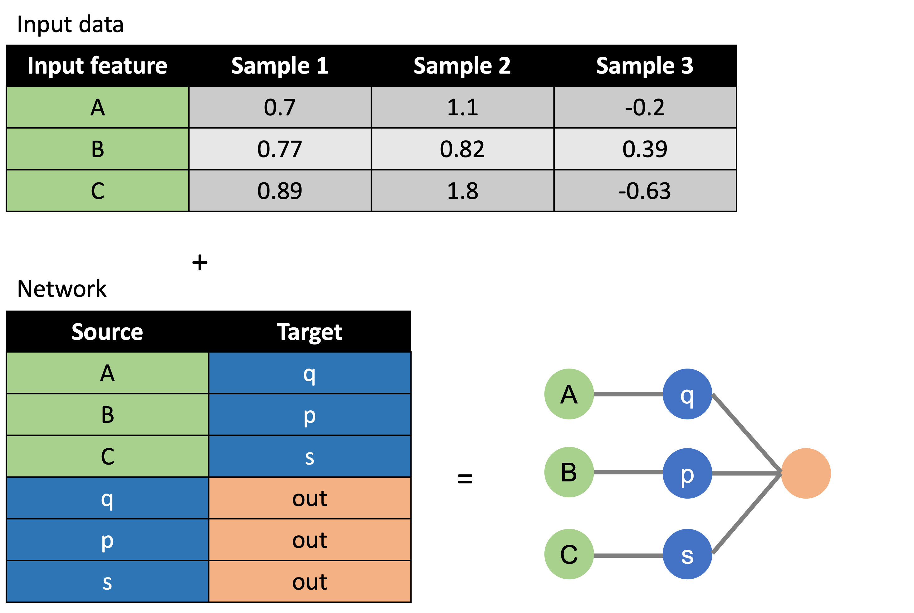
The package now allows for the creation, training, interpretation and visualization of BINNs (everything showed in this presentation)
network = Network(
input_data=input_data,
pathways=pathways,
mapping=translation
)
binn = BINN(pathways=network, n_layers=4)
https://github.com/InfectionMedicineProteomics/BINN

